Slide 1
Processing speed and multitasking performance in Counter-Strike players: A drift-diffusion model approach
Eleanor R. A. Hyde
PhD Candidate
14/02/2024

Slide 2

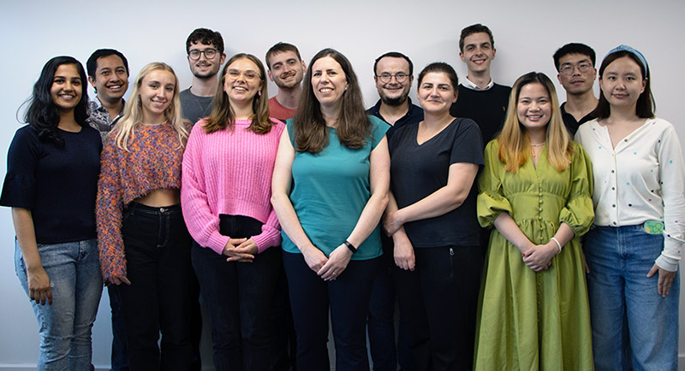



Cognitive Ability & Plasticity Lab
Dr Claudia von Bastian, Senior Lecturer
Notes:
Member of CAP Lab, headed by Dr Claudia von Bastian
Our lab investigates individual differences in cognitive abilities, particularly how our cognitive abilities can change through experience.
By understanding these differences, we can develop interventions which potentially boost cognitive performance
My line of investigation regards how our everyday experiences, such as engagement in leisure activities like video games, shapes cognition.

Slide 3
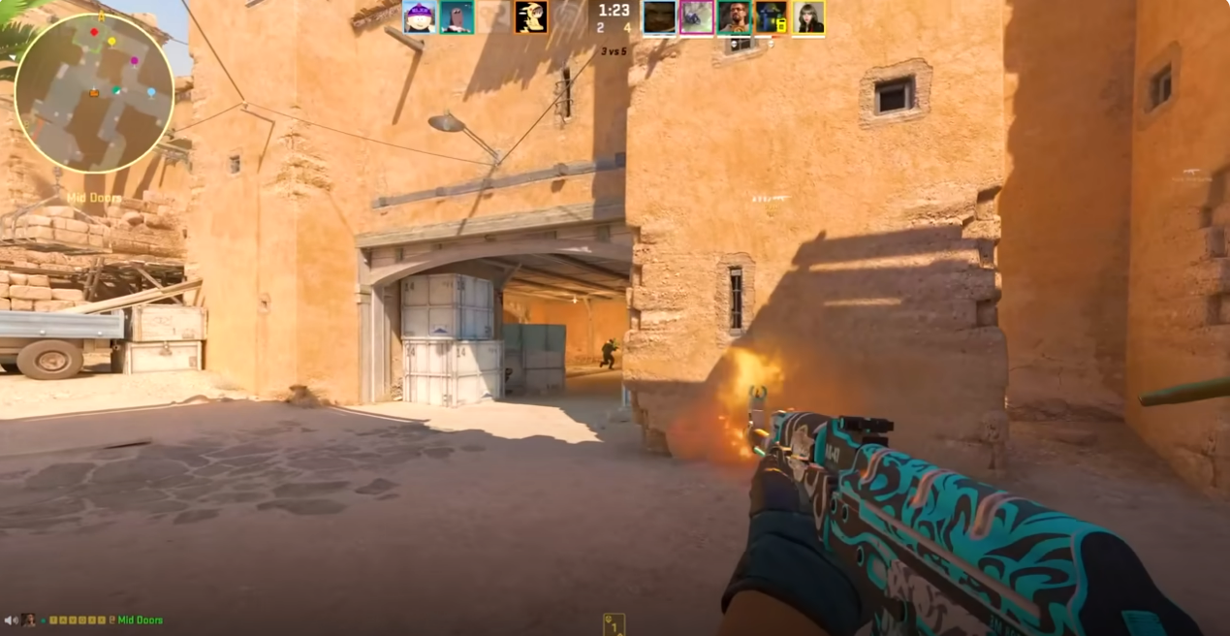
Cognitively stimulating leisure activities
Engagement in leisure activities contributes to a healthy lifestyle, but those with greater cognitive challenge show more potential for inducing cognitive improvements (von Bastian, Hyde & Jiang, 2023)
Notes:
Engagement in leisure activities is thought to contribute to a healthy lifestyle; however, not all activities are made equal, and those which involve a greater cognitive challenge show greater potential for improving cognition.
Video games are a highly popular and challenging leisure activity:
Screenshot from the video game we research, Counter-Strike which is a FPS game: typically featuring dynamic and complex environments which require players to make fast decisions or suffer in-game consequences.
Is there the potential for video games to benefit cognition?

Slide 4


Video games and cognition
Previous studies have produced inconsistent findings
Sala et al.
(2018)
Bediou et al. (2018; 2023)
Smith & Basak (2023)
Across video game genres
Action video games
Specific gameplay features
Notes:
Meta-analyses have shown a positive relationship between video play and cognition
Sala found weak correlations between video game play and cognition; however, this analysis included all video game genres
The gameplay of Mario Kart is very different to Call of Duty and likely has different cognitive implications, so it is important to be genre-specific in our research.
Bediou focused on one genre, Action Video Games (included FPS, action role-playing and action-adventure games), and found robust effects of AVG play on a range of cognitive domains such as perception and multitasking.
Smith & Basak examined specific gameplay features, found a significant effect of video game training on cognition, and that different gameplay features are differentially related to cognitive performance.
Further research is necessary in this field to understand how video game play can boost cognition, and the field would benefit from more genre-specific research investigating the cognitive correlates of specific video games.

Slide 5





First-Person Shooter (FPS)
Video games
Action video games
FPS games
Notes:
So, let’s get genre-specific. My research examines the cognitive correlates of First-Person Shooter (FPS) games, which are a sub-genre of Action video games.
Why research FPS games?
They’re the most popular genre of video games across all age groups – massive player base so we should be able to get a decent sample size compared to lesser played genres. Because they’re played by so many people, it’s important that we understand how playing these games affects cognition.
Gameplay focuses heavily on fast-paced, immersive, weapon-based combat. To succeed, you need to develop a range of cognitive and motor skills, such as hand-eye coordination and fast decision-making. If playing these games enhances those skills, perhaps we can utilise FPS games for real-world training for people in the medical profession, for example.
Loads of FPS games, these are some really popular ones – but my research regards just one FPS game, which is Counter-Strike.

Slide 6

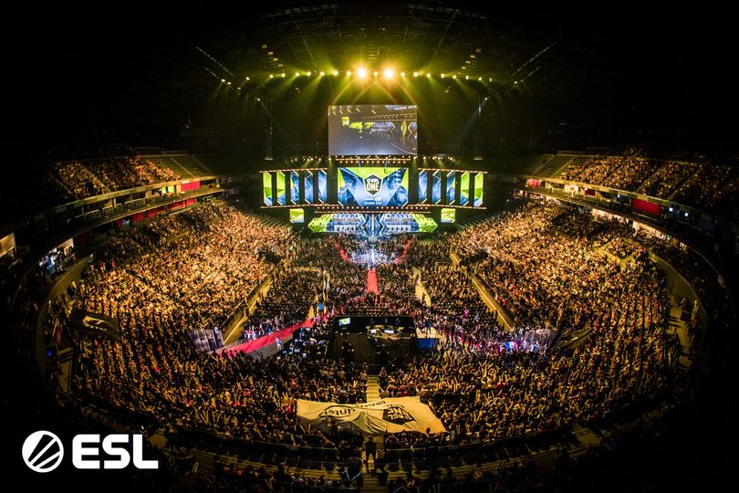
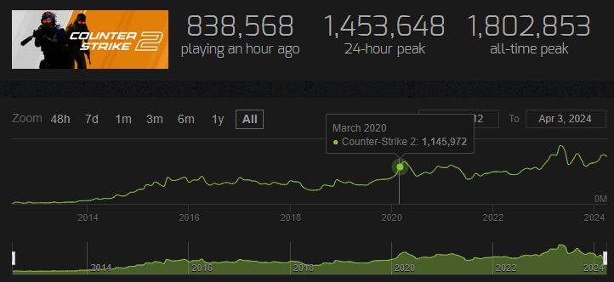
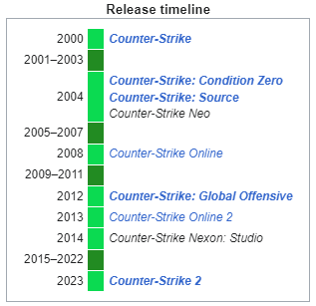
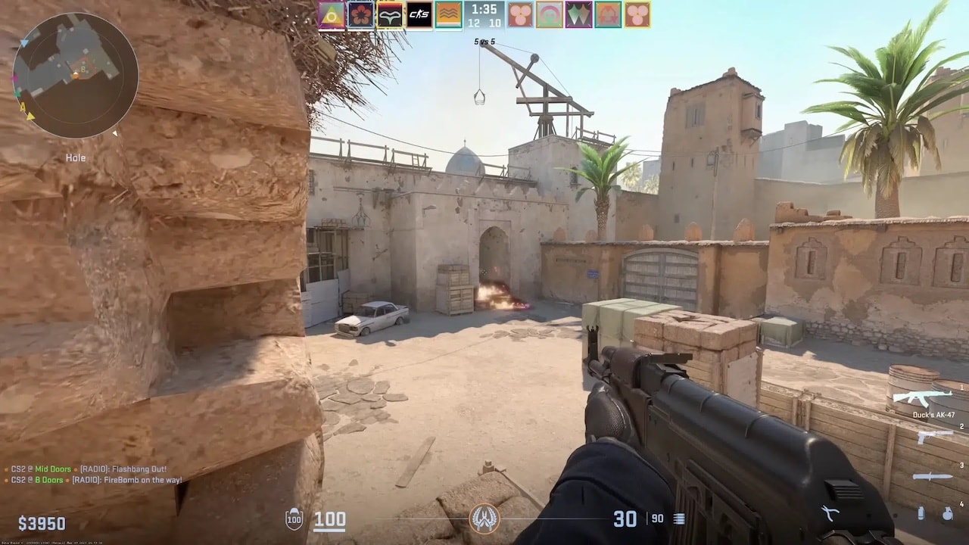
Counter-Strike 2
Notes:
The current game version is Counter-Strike 2 which came out September last year, but you might have known it as Counter-Strike: Global Offensive or CSGO before then.
CS2 is a team-based game in which one team of 5 players fights against another team of 5 players to secure sites, plant or prevent bomb planting. It’s pretty strategic in terms of teams requiring a plan and high level of communication to control the map and defeat the opposing team. It also involves skill-based gunplay where things like accuracy, reflexes and recoil control are vital for mastering each weapon – quite different to many point and shoot games. Also involves a competitive multiplayer mode where you play ranked matches against players of a similar skill level as you and move up or down these ranks based on your performance. Pretty challenging leisure activity!
Some other things worth noting about CS is that it is a free-to-play PC game which has been around for a long time —unique compared to other FPS games such as Valorant (2019) or Apex (2019), which are more recent. We get a really diverse range of CS players from around the world with a good age-range. Benefit of it being a PC only game as this is how we assess cognition as well, so there’s less likely to be cofounds of someone who has skills on a console which maybe doesn’t translate as well to a keyboard.
It’s one of the most popular FPS games, which has been gaining in popularity since the release of CS2. There’s a point I like to point out on this graph, first this peak here which is when the UK went into lockdown during the COVID pandemic. The study I’m talking about today was ran online during this time, so it was great to take advantage of that surge in interest.
Played at the professional eSports level, team of paid players compete in international tournaments for huge prize pots. It allows us to investigate cognitive abilities in these highly expert players who have played CS for years. Doing longitudinal training studies aren’t often feasible so it’s great to have this naturalistic high expertise sample to compare with more casual players.

Slide 7
Processing Speed and Multitasking performance in First-person shooter players: a Drift-Diffusion Model approach
Eleanor R. A. Hyde, Daniel J. Carroll, Robert Schmidt and Claudia C. von Bastian
In prep!
Notes:
Brings me to my research, which is the first paper from my PhD currently in prep
Titled something along the lines of Processing Speed and Multitasking performance in First-person shooter players: a Drift-Diffusion Model approach and is in preparation at the moment

Slide 8
Background
Bediou et al. (2018) found large effects for Action Video Game play on perception (processing speed), spatial cognition, top-down attention, and a medium effect for multitasking.
Bediou et al. (2023) replication finding the same as above, now a large main effect on multitasking.
Sala et al. (2018) found weak correlations between video game play and cognition.
Notes:
As I said earlier Bediou found robust effects of action video game play on cognition, specifically processing speed…
And a replication with improved methodology found the same except that the effect size for multitasking was now larger
Processing Speed and Multitasking is assumed to be important for FPS players who have to quickly process and accurately respond to multiple sources of visual information, switching between targets and other gameplay elements such as the mini-map, in-game chat and weapon-inventory.
Some inconsistent findings so far, which I have some possible explanations for which we wanted to address in our study.

Slide 9
Possible explanations
Broad definitions of video games
Small samples of novice players
Short video game training period (5 – 50 hours)
Limited assessment of video game skill and expertise
Notes:
Some studies combine lots of very different video games in the same research, so it’s difficult to disentangle the cognitive correlates of specific games.
Samples are pretty small, often very male and include people who have quite limited video game experience and thus may not show any cognitive effects from play yet.
Training studies have pretty short training periods – particularly in the context of how often people play video games. As you’ll see late in my studies 5 hours of video game play per week is pretty minimal for a lot of players.
Studies which have examined video game skill or expertise typically use one of two measures
Weekly hours playtime
Self-rated expertise (1-7)
Pretty limited self-reported measures which don’t necessarily encapsulate video game expertise.

Slide 10
Research Questions
How should we measure Counter-Strike expertise?
Is there a relationship between Counter-Strike expertise, processing speed and multitasking performance?
Processing Speed: general ability to process information, measured by Reaction Times (RTs) and Accuracy Scores
Multitasking: Ability to conduct two or more tasks at the same time, measured by Mixing Costs and Switching Costs
Notes:
With that background in mind, we had two research questions.
How should expertise in Counter-Strike be measured?
We wanted to better understand what CS expertise is and how we can measure it.
Secondly, following the promising meta-analytic findings regarding perceptual and multitasking performance in video game players,
Wanted to investigate the relationship between CS expertise, processing speed and multitasking performance
So we’re on the same page:
Processing speed is our general ability to process information and is typically measured with RTs and accuracy scores
Multitasking is our ability to do two or more tasks at the same time, typically measured by mixing and switching costs

Slide 11
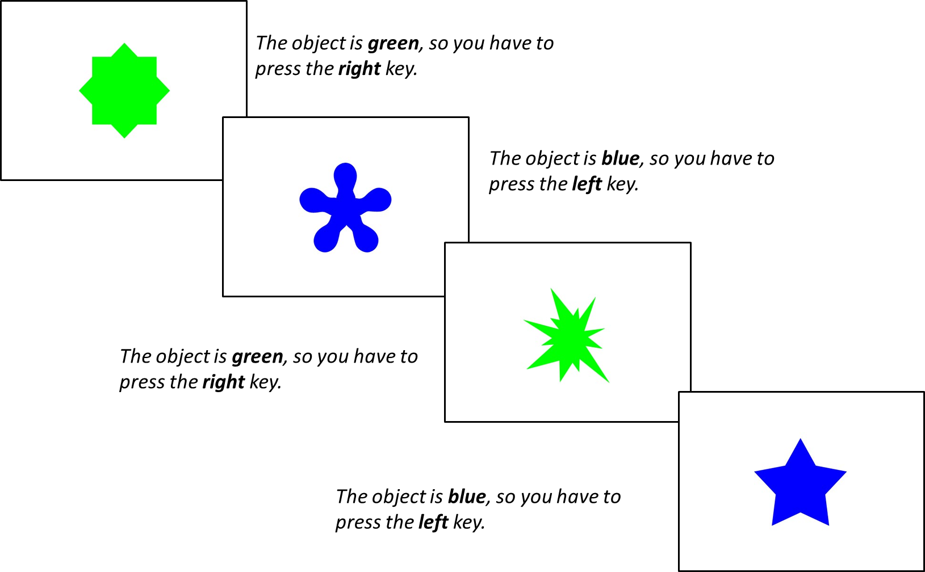
Method
Three Blocks:
Single-rule 1: 64 trials of shape followed by 64 trials of colour
Mixed-rule: 129 trials switching between shape and colour rule
Single-rule 2: 64 trials of colour followed by 64 trials of shape
n = 385
Within the Mixed-Rule Block:
Repetition trials: two successive trials in which the same rule is applied (shape + shape)
Switch trials: rule changed from the preceding trial to the current trial (shape + colour)
Choice Reaction Time Task
Notes:
Online study where participants completed a Choice RT task

Slide 12
Method
Trial Types
Single trials
Repetition trials
Switch trials
Measures
RTs
Accuracy Score
Mixing Costs: RT performance cost of mixing two tasks (repetition trial RTs – single trial RTs)
Switching Costs: RT performance cost of switching from one task to another (switch trial RTs – repetition trial RTs)
Choice Reaction Time Task
Notes:
Online study where participants completed a Choice RT task

Slide 13

Method
Choice Reaction Time Task
Pro
Expert
Casual
CS Questionnaire
Total hours of playtime
Weekly hours of playtime
Current Ranking in CS
Self-rated expertise
Notes:
Following this, they completed a Questionnaire regarding CS expertise and skill which was informed by CS players who we interviewed ahead of this study

Slide 14
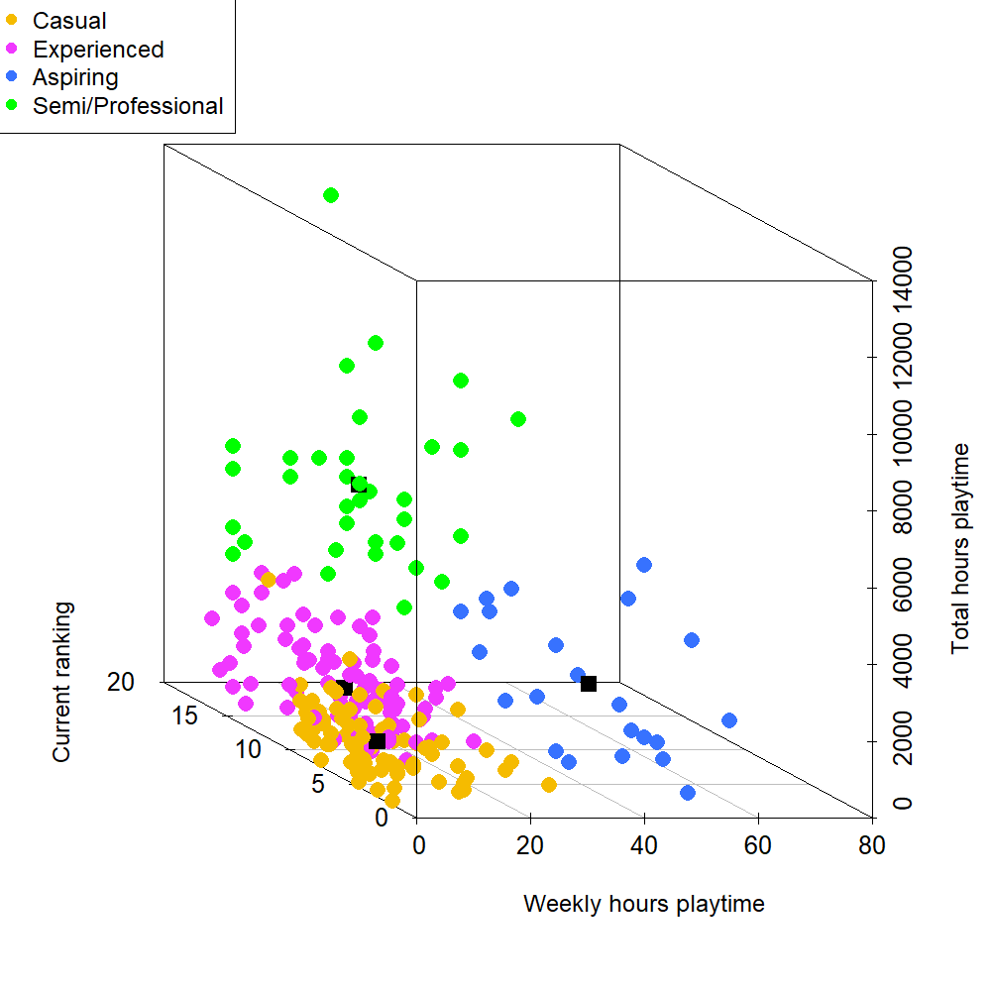
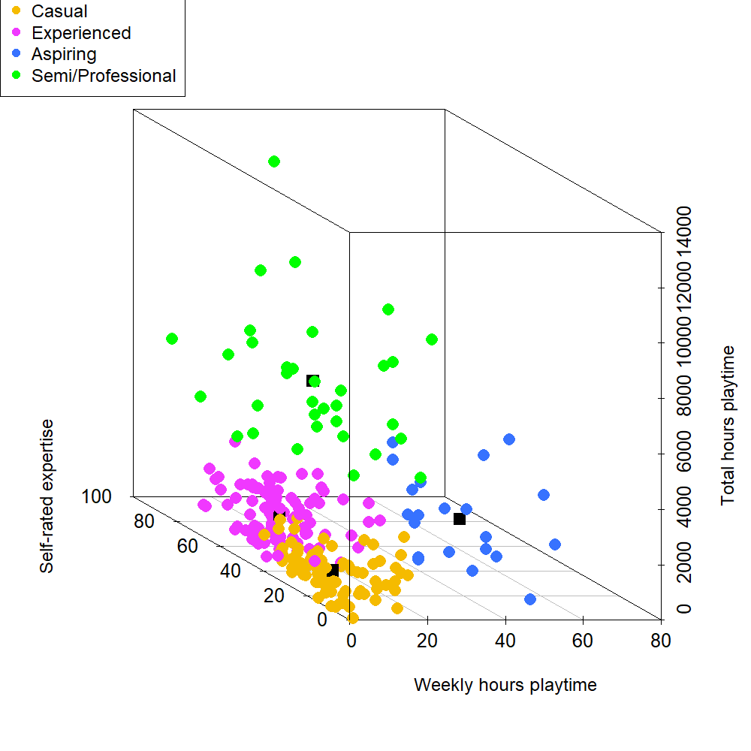
CS Expertise
N = 235
4 CS Expertise Measures
K-means cluster analysis
Semi/Professional N = 34
Aspiring N = 22
Experienced N = 101
Casual N = 78
scatterplot3d function from the scatterplot3d package in R
Notes:
305 people completed this study, and after pre-processing and accuracy filtering, we had a sample of 235, which was fantastic.
The first thing we wanted to explore was our sample’s expertise; to do this, we put our four expertise variables into a k-means cluster analysis.
An unsupervised machine learning algorithm which groups observations into k-cluster groups with minimum within-cluster variation.
Analysis suggested that 4 Cluster Groups would best fit our data: Semi/Pro, Aspiring, Experienced and Casual players.
3d scatter plot with our variables on the following axis:
weekly hours on the x
total hours on the y
current ranking on the z in the left plot and self-rated expertise on the z in the right plot
Displays the range of expertise in our participants, suggests that CS expertise is non-linear and can be measured with a multitude of measures.
Clustering gives us an amazing overview of the expertise of our sample – in greater depth than would have been possible with one measure of video game expertise.
So how did our expertise groups do on the task?

Slide 15
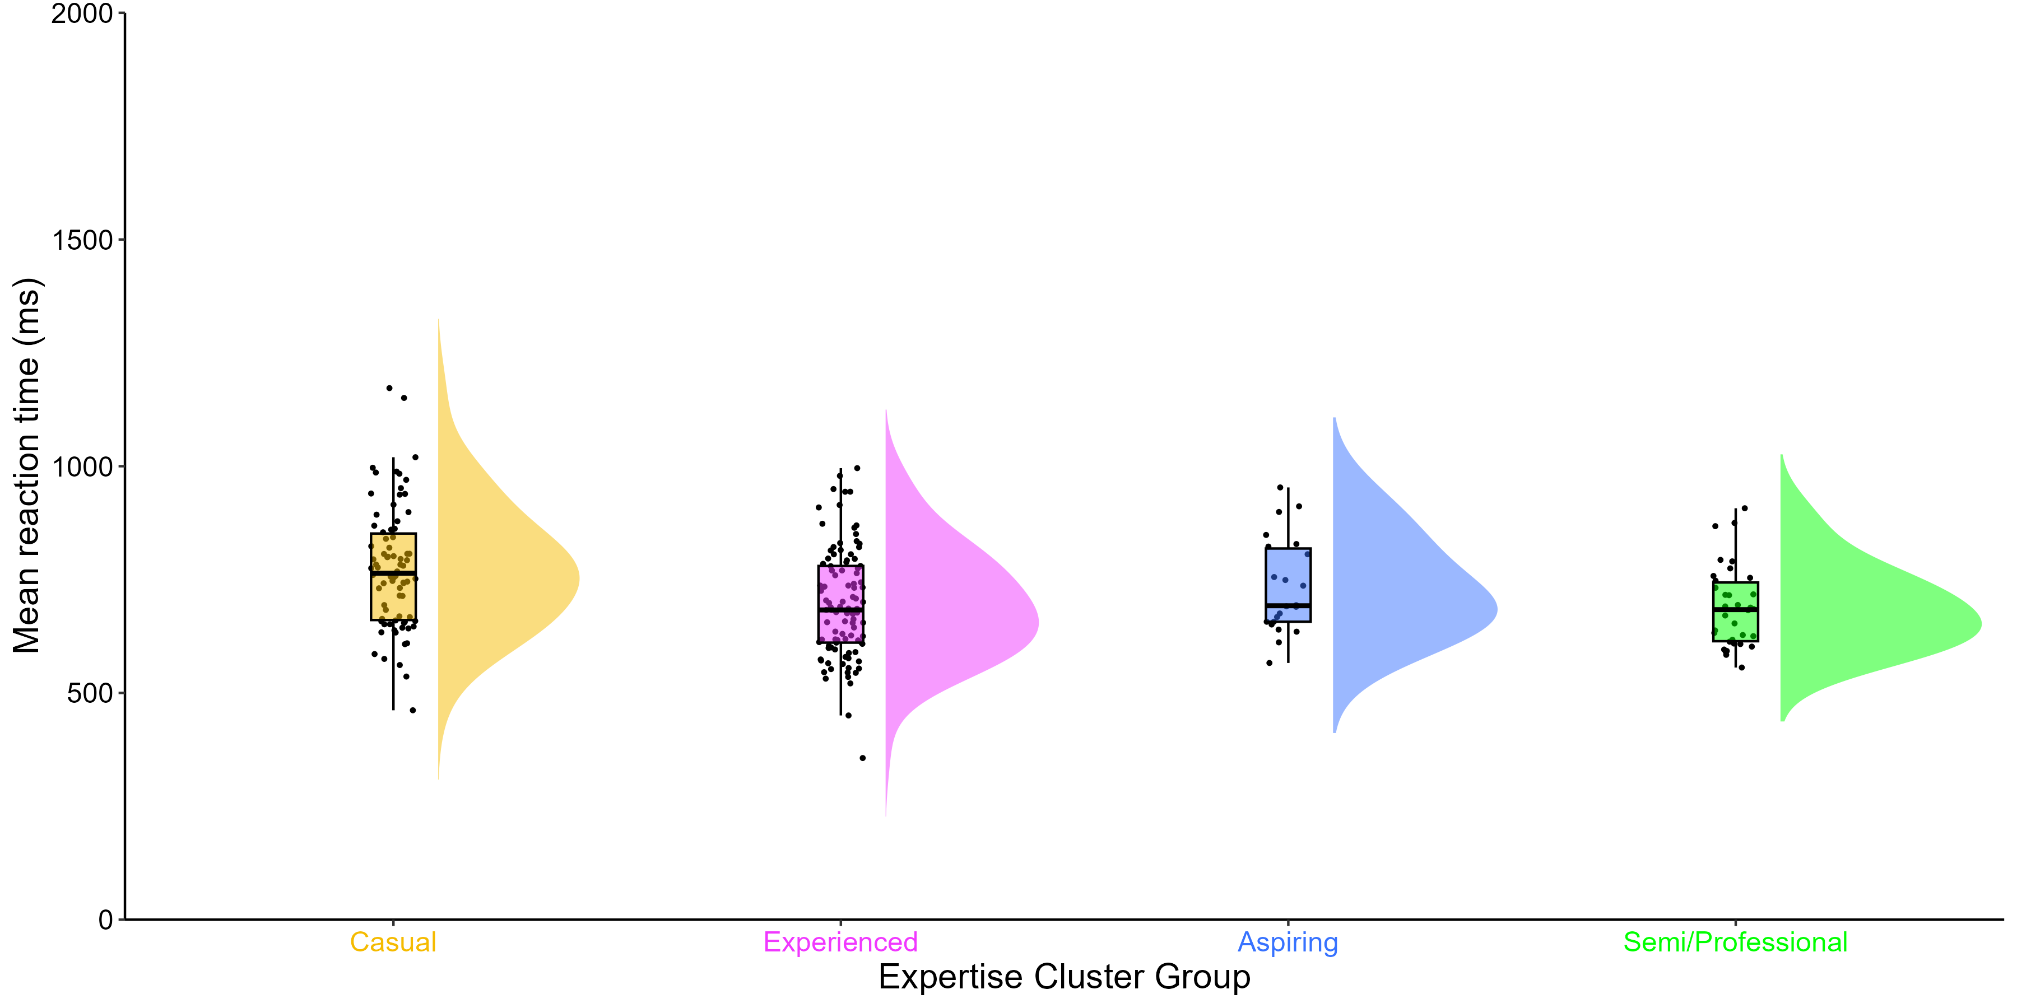
Processing Speed
No differences in accuracy scores, but decisive evidence in favour of a main effect of expertise group on mean RTs: p <.001, BF = 227.63
M = 774.31 ms
M = 733.84 ms
M = 696.61 ms
M = 688.35 ms
raincloudplots and PupillometryR packages in R
M = 591, SD = 112
Notes:
Raincloud plot:
X axis = Mean RTs
Y axis = expertise groups
Dots = participant
Box plot = summarises data from each group in terms of the maximum, minimum, interquartile range and median
Cloud = distribution
Main effect between causal and experienced players – a difference of 70 ms
Main effect between casual and professional players – a difference of 86 ms
Suggests that greater CS expertise is associated with faster processing speed performance with no sacrifices in accuracy.
But how did our expertise groups differ across the different trial types?

Slide 16
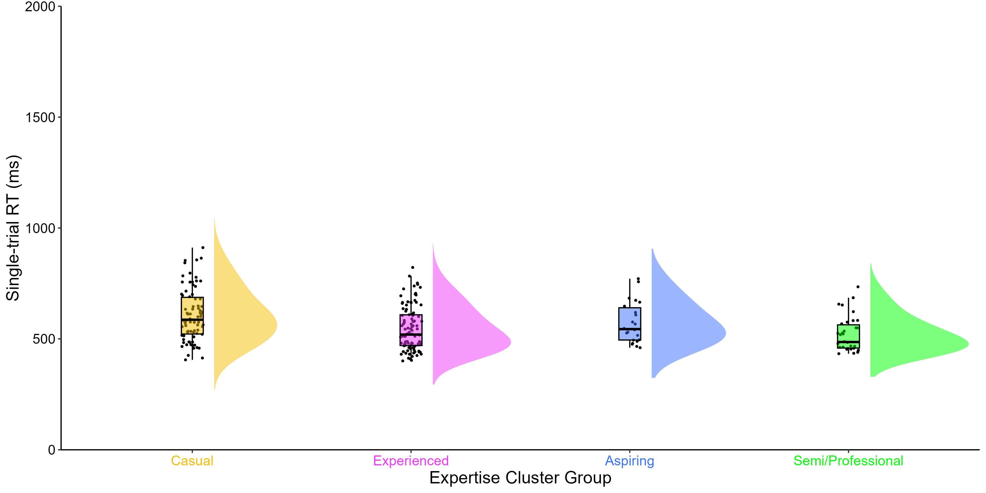
RTs across trial types
No differences in repetition trial RTs. But decisive evidence in favour of a main effect of expertise group on single trial RTs: p <.001, BF = 508.10, and switch trial RTs: p <.002, BF = 16.92
M = 607.64 ms
M = 572.44 ms
M = 544.76 ms
M = 519.12 ms
M = 591, SD = 112
Notes:
Let's look at the single trial RTs across our players
Main effect between causal and experienced players – a difference of 60 ms
Main effect between casual and professional players – a difference of 89 ms
Suggests that on single trials, greater CS expertise is associated with faster processing speed

Slide 17
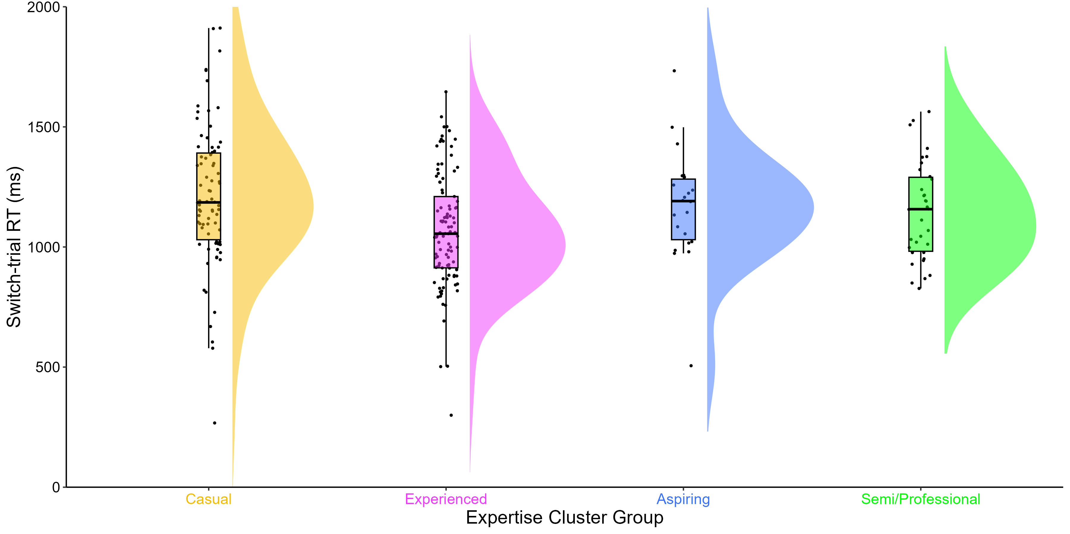
RTs across trial types
No differences in repetition trial RTs. But decisive evidence in favour of a main effect of expertise group on single trial RTs: p <.001, BF = 508.10, and switch trial RTs: p <.002, BF = 16.92
M = 1213.20 ms
M = 1170.66 ms
M = 1067.60 ms
M = 1147.87 ms
M = 591, SD = 112
Notes:
For switch trials the Bayes Factor is much smaller than it is for single trials, just one group main effect:
Main effect between causal and experienced players – a difference of 145 ms
And the distributions are much wider for switch trials.
Notice: Experienced players have the fastest RTs whilst our casual, aspiring and semi/professionals are much slower
This of course, will have ramifications on mixing and switching costs.

Slide 18
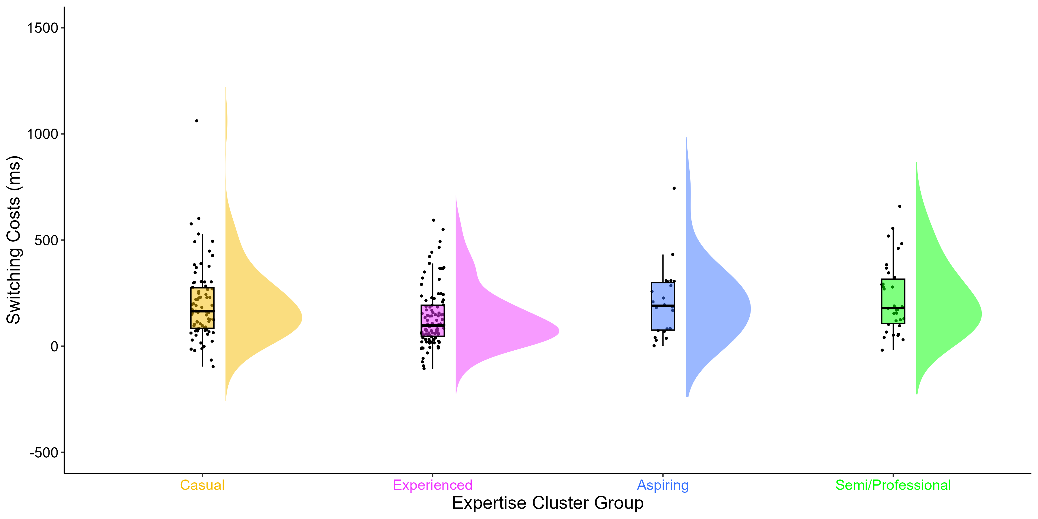
Multitasking Costs
No differences in mixing costs. But substantial evidence in favour of a main effect of expertise group on switching costs: p <.006, BF = 6.56
M = 200.19 ms
M = 205.77 ms
M = 135.64 ms
M = 227.72 ms
M = 591, SD = 112
Notes:
Mixing Costs: RT performance cost of mixing two tasks (repetition trial RTs – single trial RTs)
Switching Costs: RT performance cost of switching from one task to another (switch trial RTs – repetition trial RTs)
Mixing costs were similar across groups, but switching costs were quite different.
Main effect between experienced and causal players – a difference of 65 ms
Main effect between experienced and professional players – a difference of 92 ms
Switching costs were lowest (best) in experienced players and highest (worse) in semi/professional players.
Suggests that less expert CS players have greater switching ability compared to more expert players – opposite of what we would have expected.
What does that mean? … we’ll come back to that.

Slide 19

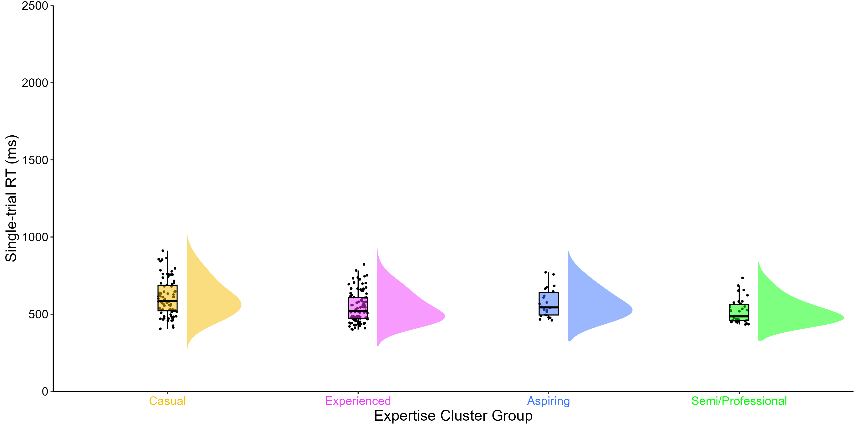
Summary
No differences in accuracy, but Semi/Professional players have faster RTs.
No differences in mixing costs, but Experienced players have the lowest switching costs.
Green
Blue
Notes:
To summarise, we found no differences in accuracy between our expertise groups, but we found Semi/Professional players to have faster RTs than less expert players. This was evident on single and switch trials (shorter RTs).
We also found no differences in mixing between our expertise groups, but we found Experienced players to have better switching performance (lower switch costs).
To investigate this further, we used a Drift-Diffusion Model, which is a computational model of decision-making processes which takes the RT and accuracy score measures from our Choice RT task and decomposes them into isolated components.

Slide 20
Drift-diffusion model (DDM)
1. Drift Rate (v)
information accumulation
2. Boundary Separation (a)
response caution
3. Non-decision time (t0)
other non-decisional processes
Green
Drift Rate (v)
Boundary Separation (a)
Blue
Stimuli Encoding
Decision Time
Response Execution
Non-decision time (t0)
Notes:
DDM parameters correspond to latent cognitive processes:
After the initial encoding of stimuli, for example, a shape that could be blue or green, there is a noisy period of evidence accumulation until the information is sufficiently clear.
The slope of information accumulation, known as drift rate (v), represents how efficiently stimuli information is processed. Once a decisional threshold is reached (i.e., if the shape is blue or green) then a response is executed.
The distance between the two choices reflects response caution, known as boundary separation (a) and indicates a possible speed-accuracy-trade-off. If the individual favours speed, their narrow boundary separation indicates low response caution whereas if they favour accuracy, their wide boundary reparation would indicate high response caution. A response is executed once a decision has been made (pressing a key).
The final component, non-decision time (t0) represents the time period of other processes which are not related to the decision itself such as stimuli encoding and response execution
The model provides additional insight into the underlying cognitive processes within a Choice RT Task, beyond that of RT and Accuracy Scores.

Slide 21
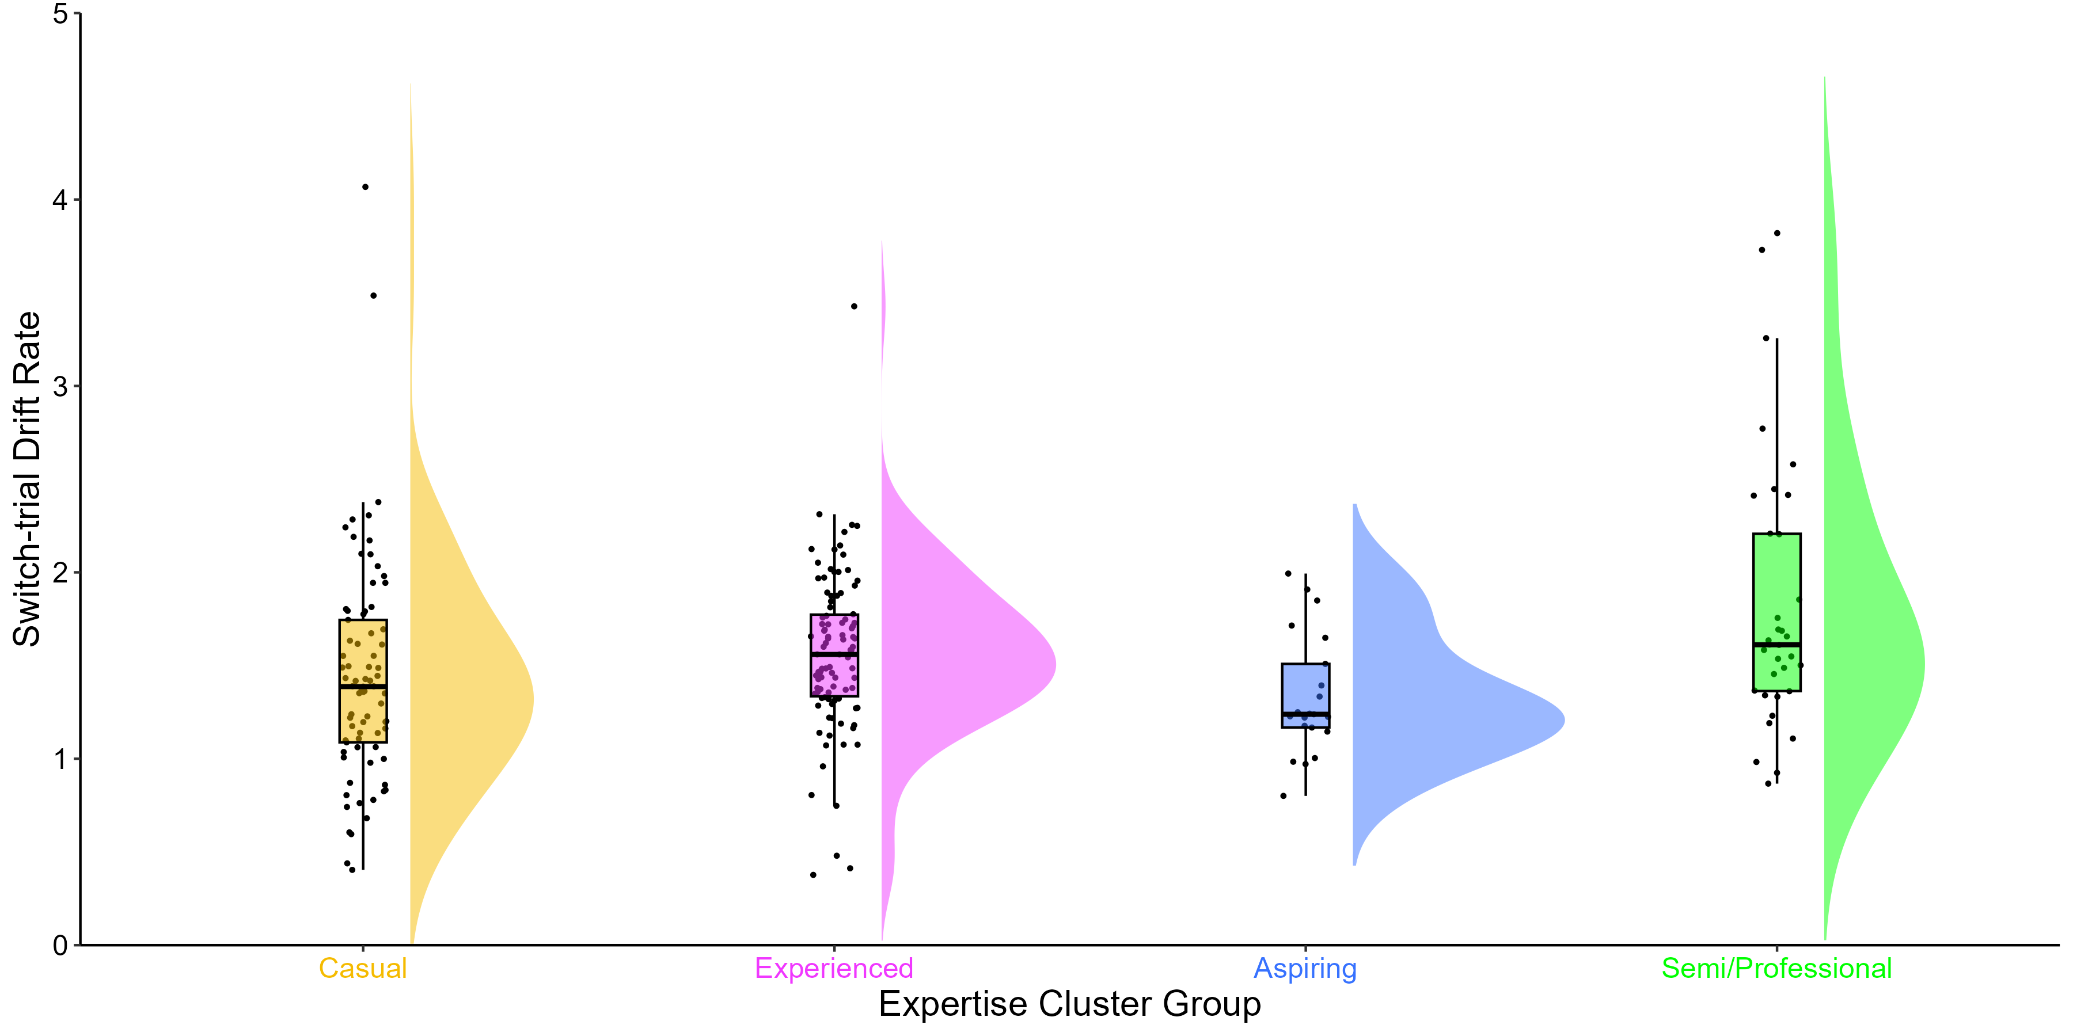
Drift rates (v) across trial types
No differences in single trial or repetition trial drift rates. But, substantial evidence in favour of a main effect of expertise group on switch drift rates: p =.006, BF = 3.67
M = 1.44
M = 1.58
M = 1.35
M = 1.83
(v)
M = 591, SD = 112
Notes:
For switch trials, our semi/professional players had the highest (best) drift rates.
Main effect between aspiring and professional players – a difference of 0.50
Suggests that more expert CS players have greater information accumulation on the more challenging switch trials, despire their greater switch costs we saw earlier.
However, the data here is pretty noisy – distributions and flat and wide and we only have evidence in switch trials so not decisive evidence here.

Slide 22
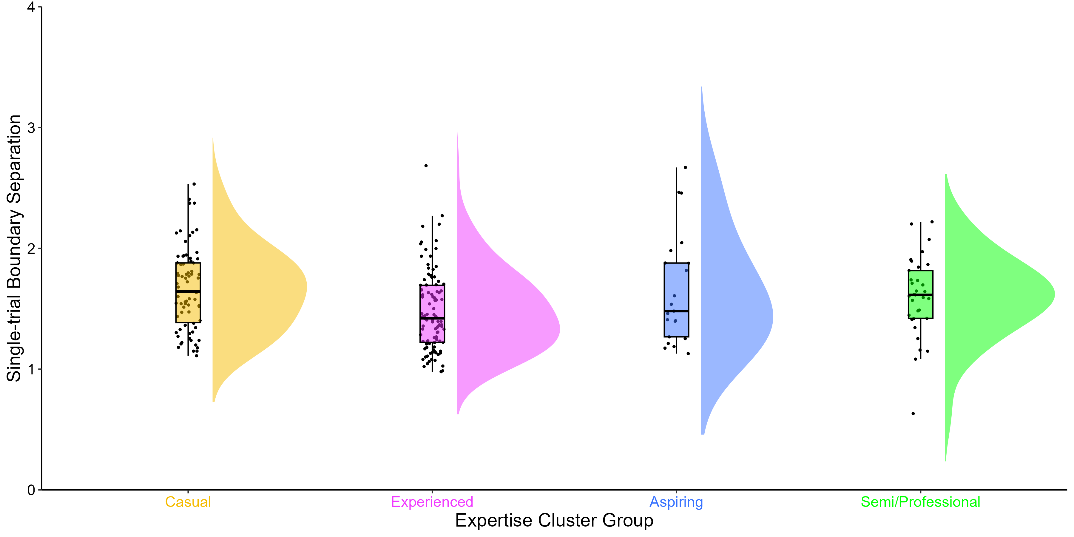
Boundary Separations (a) across trial types
No differences in repetition trial or switch trial boundary separations. But, substantial evidence in favour of a main effect of expertise group on single trial boundary separations: p =.011, BF = 3.73
M = 1.75
M = 1.48
M = 1.65
M = 1.80
(a)
M = 591, SD = 112
Notes:
For single trials, our semi/professional players had the higher boundary separations, pretty close to casual players.
Main effect between experienced and casual players – a difference of 0.27
Suggests that more expert CS players show greater boundary separations on single trials, meaning they exhibit greater caution in their decision, suggesting that they prefer to gather more information before committing to their choice.
Again, the data here is pretty noisy—the distributions are flat and wide, and we only have evidence in single trials, so there is not decisive evidence here.

Slide 23
Non-decision times (t0) across trial types
No differences in repetition trial and switch trial non-decision times. But, decisive evidence in favour of a main effect of expertise group on single trial non-decision times: p <.001, BF = 279.59
M = 0.29
M = 0.28
M = 0.25
M = 0.23
(t0)
M = 591, SD = 112
Notes:
For single trials, our semi/professional players had the shortest (best) non-decision times.
Main effect between casual and professional players – a difference of 0.06
Main effect between experienced and professional players – a difference of 0.05
Suggests that more expert CS players have greater encoding and response execution on single trials, meaning that they process and respond to sensory information faster and more efficiently. This is evident in their fast RTs on single trials.
Contrary to drift rates and boundary separations, the distributions are pretty normal here and we have decisive Bayesian evidence.
Perhaps they key process responsible for faster RTs in more expert CS players is the advantages in non-decision time.

Slide 24
Conclusions
1. CS expertise is a multi-dimensional construct that can be measured by a range of variables and k-means clustering.
Notes:
K-means clustering is one method
But, it remains to be seen if we find the same expertise groups in other samples. We have plans to test that this year.
These four measures may not be applicable to other FPS games or video games from other genres. We’re working with collaborators to generate a similar questionnaire and variables for other games presently.

Slide 25
Conclusions
1. CS expertise is a multi-dimensional construct that can be measured by a range of variables and k-means clustering.
2. Highly expert Semi/Professional players have advantages in processing speed performance, with no sacrifices in accuracy.
Notes:
Whilst correlational, it suggests that more expert FPS players have advantages in processing speed with no evidence of a speed-accuracy trade-off.
However, we don’t know the direction of this relationship. Do players improve their processing speed through playing FPS games, or do people with greater processing speed abilities play FPS games?

Slide 26
Conclusions
1. CS expertise is a multi-dimensional construct that can be measured by a range of variables and k-means clustering.
2. Highly expert Semi/Professional players have advantages in processing speed performance, with no sacrifices in accuracy.
3. Experienced players have better switching performance, but there were no differences in mixing performance.
Notes:
Why do our Experienced players, as opposed to our Semi/Professional players show a greater ability to switch between tasks?
One explanation could be that perhaps the this cost is associated with the very fast repetition RTs in semi/professionals, to rule this out we calculated proportional switch costs and found the same finding – that experienced players have better switching performance than other expertise groups.
A theory we had is that perhaps expert players do no multitask as much in game as newer players. When you’re new to a game you jump about a lot, as you before more expert your role is clearly defined – an eye-tracking pilot we did recently supports this, showing that more expert players jump around the visual display less than casual players. But more investigation and thinking needs to be done surrounding this finding. I’d be interested to hear what you think about it!

Slide 27
Conclusions
1. CS expertise is a multi-dimensional construct that can be measured by a range of variables and k-means clustering.
2. Highly expert Semi/Professional players have advantages in processing speed performance, with no sacrifices in accuracy.
3. Experienced players have better switching performance, but there were no differences in mixing performance.
4. Limited evidence for differences in drift rates and boundary separations, but Semi/Professional players have faster non-decision times.
Notes:
Finally, for the drift parameters, we found …
Key component in FPS players fast decision making is fast encoding and motor response
This might indicate greater cognitive efficiency – players can process information and generate a motor response with minimal delay or inefficiency.
Capacity-efficiency model, which Claudia has done work on, in the context of video game training would be facintating to investigate here.

Slide 28



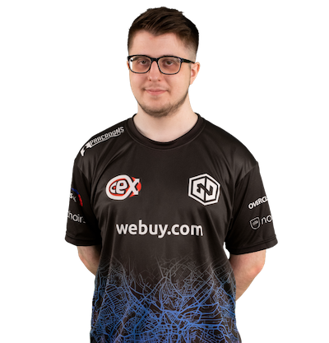

Final comments
Can we train individuals who have slower processing speed (cognitive aging, ADHD, dyslexia) with FPS games and boost their processing speed performance?
Participatory research: collaborate with those experts who are affected by and understand the field in the design of your study and methods.
Notes:
But, of course, there is always the question of the directionality of causality. Do people with faster processing speed performance play FPS games, or does playing FPS games boost processing speed performance?
This study doesn’t answer that question, but I hope to do some longitudinal work in the future to shed some light on this. Perhaps one day we’ll be asking your grandparents to come into our lab and play Counter-Strike!
But before then, we have lots of gameplay elements to consider, such as the videogame perspective, sound, levels, user interface, competitive play, and interaction with players – which may differentially impact cognition.
When developing video game research proposals, involve people who know the most about those games so that you can best develop study methodology – for example measures of expertise. This is how we can continue to generate good collaborative science.

Slide 29






Thanks for listening!
erahyde1@sheffield.ac.uk
www.eleanorhyde.com
Dr Claudia von Bastian
The University of Sheffield
Dr Robert Schmidt
Ruhr-Universität Bochum
Dr Dan Carroll
The University of Sheffield
Endpoint
Notes:
With that, I’d like to thank my amazing supervisory team and Endpoint (our eSports team collaborator).
I’d like to thank Tim again for the invitation to speak
And to everyone listening thanks for your attention!

Slide 30
Participants (N = 235)
 | Full Sample |  | Casual |  | Experienced |  | Aspiring |  | Semi/Professional
 | M | SD | M | SD | M | SD | M | SD | M | SD
Gender Male/Female/Non-Binary/Prefer not to say | 211/21/1/2 |  | 71/6/1/0/1 |  | 84/15/1/1 |  | 22/0/0/0 |  | 34/0/0/0
Age | 21.93 | 4.69 | 21.27 | 4.79 | 23.77 | 4.64 | 18.05 | 2.64 | 20.38 | 3.02
Total hours of playtime | 1565.16 | 1926.80 | 624.17 | 534.54 | 1010.11 | 862.32 | 1469.11 | 970.88 | 5434.88 | 2082.08
Weekly hours of playtime | 20.34 | 15.85 | 10.26 | 7.55 | 17.05 | 7.98 | 55.55 | 12.11 | 30.41 | 12.54
Self-rated expertise | 50.68 | 23.48 | 26.12 | 12.30 | 62.96 | 15.33 | 48.95 | 17.59 | 71.65 | 17.50
Current Ranking | 12.04 | 4.68 | 7.74 | 2.86 | 13.39 | 2.98 | 11.41 | 5.11 | 18.29 | 1.77

Slide 31
 | Full Sample |  | Casual |  | Experienced |  | Aspiring |  | Semi/Professional
 | M | SD | M | SD | M | SD | M | SD | M | SD
Score
Mean | 0.94 | 0.04 | 0.94 | 0.04 | 0.94 | 0.04 | 0.93 | 0.05 | 0.95 | 0.04
Single-trials | 0.94 | 0.04 | 0.95 | 0.04 | 0.94 | 0.04 | 0.93 | 0.06 | 0.95 | 0.06
Repetition-trials | 0.95 | 0.07 | 0.94 | 0.08 | 0.95 | 0.08 | 0.95 | 0.05 | 0.96 | 0.04
Switch-trials | 0.91 | 0.08 | 0.91 | 0.08 | 0.91 | 0.09 | 0.91 | 0.06 | 0.94 | 0.04
Reaction Time
Mean | 724.69 | 125.34 | 774.31 | 135.32 | 696.61 | 120.38 | 733.84 | 106.13 | 688.35 | 89.15
Mean Correct | 728.52 | 126.10 | 777.89 | 135.12 | 699 | 121.37 | 740.83 | 103.62 | 694.99 | 94.83
Single-trials | 564.51 | 107.66 | 607.64 | 118.6 | 544.76 | 99.13 | 572.44 | 93.53 | 519.12 | 79.2
Repetition-trials | 960.24 | 212.01 | 1013.01 | 249.45 | 931.97 | 198.46 | 964.89 | 168.83 | 920.15 | 159.25
Switch-trials | 1137.19 | 260.92 | 1213.20 | 295.47 | 1067.60 | 238.71 | 1170.66 | 236.54 | 1147.87 | 203.57
Reaction Time Costs
Mixing | 395.73 | 177.98 | 405.37 | 223.18 | 387.21 | 156.32 | 392.45 | 167.72 | 401.02 | 126.41
Switching | 176.95 | 162.89 | 200.19 | 177.58 | 135.64 | 139.59 | 205.77 | 167.5 | 227.72 | 167.16
Proportional | 1.18 |  | 1.20 |  | 1.15 |  | 1.21 |  | 1.25
Drift Rate
Single-trials | 2.68 | 0.80 | 2.66 | 0.91 | 2.69 | 0.63 | 2.35 | 0.66 | 2.91 | 1.01
Repetition-trials | 2.08 | 0.90 | 1.97 | 0.88 | 2.13 | 0.91 | 1.84 | 0.43 | 2.36 | 1.08
Switch-trials | 1.55 | 0.61 | 1.44 | 0.60 | 1.58 | 0.59 | 1.35 | 0.33 | 1.83 | 0.74
Boundary Separation
Single-trials | 1.63 | 0.62 | 1.75 | 0.56 | 1.48 | 0.33 | 1.65 | 0.45 | 1.80 | 1.19
Repetition-trials | 2.42 | 1.38 | 2.53 | 1.39 | 2.27 | 1.27 | 2.29 | 0.81 | 2.74 | 1.83
Switch-trials | 2.19 | 1.08 | 2.32 | 1.22 | 2.04 | 1.01 | 2.11 | 0.53 | 2.40 | 1.19
Non-decision Time
Single-trials | 0.28 | 0.08 | 0.29 | 0.08 | 0.28 | 0.07 | 0.25 | 0.07 | 0.23 | 0.10
Repetition-trials | 0.42 | 0.16 | 0.42 | 0.17 | 0.44 | 0.15 | 0.39 | 0.16 | 0.38 | 0.15
Switch-trials | 0.51 | 0.15 | 0.51 | 0.18 | 0.51 | 0.14 | 0.49 | 0.12 | 0.52 | 0.14

Slide 33
Table 3. Descriptive statistics for other expertise variables for the full sample and cluster groups.
 | Full Sample | Full Sample |  | Casual | Casual |  | Experienced | Experienced |  | Aspiring | Aspiring |  | Semi/Professional | Semi/Professional
 | n | M | SD | n | M | SD | n | M | SD | n | M | SD | n | M | SD
Age started | 235 | 16.22 | 4.16 | 78 | 16.49 | 4.42 | 101 | 17.38 | 3.76 | 22 | 14.27 | 2.78 | 34 | 13.44 | 3.82
Years of playtime | 232 | 5.65 | 3.64 | 77 | 4.75 | 3.53 | 100 | 6.32 | 3.49 | 21 | 3.67 | 2.29 | 34 | 6.94 | 4.11
Tournament placements | 71 | 4.11 | 1.19 | 9 | 3.56 | 1.74 | 42 | 4.24 | 0.93 | 7 | 3.57 | 1.81 | 13 | 4.38 | 1.04
Tournament stage | 84 | 3.58 | 1.40 | 9 | 2.44 | 1.13 | 45 | 3.76 | 1.37 | 9 | 3.11 | 1.69 | 21 | 3.90 | 1.22
Tournament prize | 31 | 1054.93 | 1247.36 | 0 | - | - | 18 | 1219.81 | 1125.89 | 3 | 27.00 | 21.76 | 9 | 1182.13 | 1591.52
Standard Matchmaking: Current ranking | 235 | 12.04 | 4.68 | 78 | 7.74 | 2.86 | 101 | 13.39 | 2.98 | 22 | 11.41 | 5.11 | 34 | 18.29 | 1.77
Standard Matchmaking: Highest ranking | 235 | 13.19 | 4.40 | 78 | 9.72 | 3.61 | 101 | 14.09 | 3.13 | 22 | 12.73 | 4.47 | 34 | 18.76 | 1.05
Standard Matchmaking: Goal ranking | 214 | 15.83 | 3.61 | 73 | 13.37 | 3.63 | 96 | 16.85 | 2.60 | 19 | 17.16 | 3.17 | 26 | 17.96 | 3.57
FACEIT Matchmaking: Current ranking | 91 | 7.99 | 2.31 | 7 | 5.71 | 1.89 | 43 | 7.63 | 1.95 | 10 | 6.10 | 2.18 | 31 | 9.61 | 1.80
FACEIT Matchmaking: Highest ranking | 91 | 8.65 | 2.16 | 7 | 6.14 | 1.95 | 43 | 8.07 | 1.70 | 10 | 7.10 | 2.33 | 31 | 10.52 | 1.09
FACEIT Matchmaking: Goal ranking | 83 | 11.29 | 1.49 | 6 | 9.67 | 2.42 | 40 | 10.82 | 1.30 | 9 | 11.33 | 1.41 | 28 | 12.29 | 0.85
ESEA Matchmaking: Current ranking | 9 | 10.33 | 2.00 | 0 | - | - | 9 | 10.33 | 2.00 | 0 | - | - | 0 | - | -
ESEA Matchmaking: Highest ranking | 9 | 10.11 | 2.47 | 0 | - | - | 9 | 10.11 | 2.47 | 0 | - | - | 0 | - | -
ESEA Matchmaking: Goal ranking | 9 | 12.78 | 2.49 | 0 | - | - | 9 | 12.78 | 2.49 | 0 | - | - | 0 | - | -

